Slide 1
Discrete Mathematics
Unit 3
3
Mathematical Reasoning, induction and recursion

Slide 2
Principle of Mathematical induction :-
Statement :-
Let S(n) be a statement that involves positive integer n = 1, 2, 3, ……….. then S(n) is true for all positive integer n provided that
① S(1) is true
② S(K+1) is true whenever S(K) is true.
Note:-
There are 3 steps to proof using the principle of mathematical induction.
Step 1 :-
( Inductive base ) verify that S(1) is true
Step 2 :-
( Inductive hypothesis ) assume that S(K) is true for any value of k.
Step 3 :-
( Inductive step ) verify that S(K+1) is true on basis of the inductive hypothesis.

Slide 3
Example:
Prove using mathematical induction that the sum of the first n even numbers is n(n+1).
i.e. 2 + 4 + 6 + 8………..+ 2n = n(n + 1)
Proof:-
Let S(n) be the statement
S(n): 2 + 4 + 6 + 8 +………..+ 2n = n(n + 1)
Inductive base:-
For n = 1, We have
2 = 1(1+1) = 2
So, S(1) is true.
Inductive hypothesis:-
Assume that S(K) is true, whenever S(n) is true,
i.e. 2 + 4 +6 + 8 +………………+ 2K = K(K + 1)
Inductive step:-
We wish to show that S(K+1) is true when S(K) is true
i.e. 2 + 4 + 6 + 8 +………+ 2K + 2(K + 1) = (K + 1) (K + 2)
7/30/2023

Slide 4
Now,
2 + 4 + 6 + 8 +……….+ 2K + 2(K + 1)
= (2 + 4 + 6 +…..+ 2k) + 2(k + 1)
= K(K + 1) + 2(K + 1)
= (K + 1) (K + 2)
Hence, S(n) is true for all positive integer n.
Example – 2 Use mathematical induction to prove 2^{n} < n! for every positive integer n with n ≥ 4.
Solution:
Let P(n) be the proposition that 2^{n} < n!
Basis step: To prove the inequality for, n ≥ 4 requires that the basis step be P(4) .
P(4) is true because 2⁴ = 16 < 24 = 4!
Inductive hypothesis:-
we assume that P(k) is true for the positive integer k with k ≥ 4
i.e, we assume that, 2^{k} < k! for the positive integer k with k ≥ 4.

Slide 5
inductive step:
We must show that under this hypothesis, P(k + 1) is also true.
i.e, we must show that if 2^{k} < k! for the positive integer k where k ≥ 4 then, 2^{k + 1} < (k + 1)!.
So, 2^{k + 1} = 2 . 2^{k}
< 2 .k!
< (k + 1) . k!
= (k+1)!
This show that P(k + 1) is true when P(k) is true. So, for all positive integer. 2^{n} < n!.
Example – 3 Use mathematical induction to prove that for any integer n, n³ – n is divisible by 6.
Proof:-
Let S(n) be the statement
i.e. S(n) = n³ – n is divisible by 6.
Now, S(1) = 1³ – 1 = 0, is divisible by 6.
S(2) = 2³ – 2 = 6, is divisible by 6.
So the given statement is true for n = 1, 2.
We assume that S(k) is true for some integer n = k.
i.e. S(k) = k³ – k is divisible by 6.
Let S(k) = 6k₁ (k₁ is any integer) ……….(1)

Slide 6
Finally, we have to show that S(k + 1) is true whenever S(k) is true.
Now,
S(k + 1)
= (K + 1 )³ – (k + 1)
= K³ + 3k² + 3k + 1 – k – 1
= K³ – k + 3k² + 3k
= (K³ – k) + 3k(k + 1)
∴ S(k + 1)
= (K³ – k) + 3k(k + 1) ………..(2)
Since k(k + 1) is the product of two consecutive integers, which is always divisible by 2.
Then we can write k(k +1) = 2k₂ (k₂ is any integer)
From equation (1) and (2) we get,
S(k + 1) = (K³ – k) + 3k(k + 1)
S(k + 1) = 6k₁+ 3(2k₂) = 6(k₁ + k₂), k_{1,} k₂ is any integer then k₁ + k₂ integer.
So S(k + 1) is also divisible by 6.
Hence the statement is true for all integer n.

Slide 7
Strong induction:
Principle of strong induction:
To prove that P(n) is true for all positive integers n we complete two steps
Basis step:
Verify P(1) is true
Inductive step:
Show [P(1)^P(2) ^…^P(k)] → P(k+1) is true for all positive integers k.

Slide 8
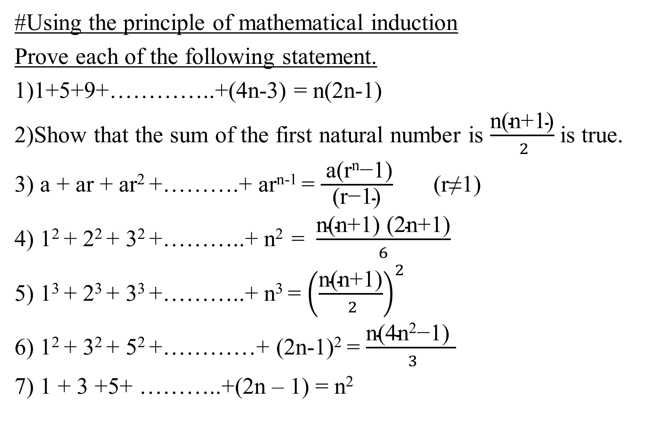
#Using the principle of mathematical induction
Prove each of the following statement.
1)1+5+9+…………..+(4n-3) = n(2n-1)
2)Show that the sum of the first natural number is $\frac{\text{n}\text{(}\text{n}\text{+1)}}{ 2}$ is true.
3) a + ar + ar² +……….+ ar^{n-1} = $\frac{ \text{a}\text{(}\text{rn}\text{−1)}}{\text{(}\text{r}\text{−1)}}$ (r≠1)
4) 1² + 2² + 3² +………..+ n² = $\frac{\text{n}\text{(}\text{n}\text{+1) (2}\text{n}\text{+1)}}{6}$
5) 1³ + 2³ + 3³ +………..+ n³ = ${\left(\frac{\text{n}\text{(}\text{n}\text{+1)}}{ 2}\right)}^{2}$
6) 1² + 3² + 5² +…………+ (2n-1)² = $\frac{\text{n}\text{(4}\text{n}\text{2}\text{−1) }}{ 3}$
7) 1 + 3 +5+ ………..+(2n – 1) = n²
7/30/2023

Slide 9
Recursive definitions:-
Sometimes it is difficult to define an object explicitly. However, it may be easy to define this object in terms of itself. This process is called recursion.
Basis step:-
Specify the value of the function at zero.
Recursive step:-
Give a rule for finding its value at an integer from its values at smaller integers. Such a definition is called a
recursive.
Example:-
Suppose that f is defined recursively by f(0) = 3, f(n+1) = 2f(n) + 3.
Find f(1), f(2), f(3)
Solution:-
from the recursive definition it follows that :
f(1) = 2f(0) + 3 = 2×3 + 3 = 9
f(2) = 2f(1) + 3 = 2×9 + 3 = 21
f(3) = 2f(2) + 3 = 2×21 + 3 = 45
7/30/2023

Slide 10
Recurrence relation
A recurrence relation is an equation that expresses each element of a sequence as a function of the preceding ones. More precisely, in the case where only the immediately preceding element is involved, a recurrence relation has the form
a_{n} = f(n, a_{n – 1} ) for n > 1
Example: Find the recurrence relation of the sequence 1, 3, 7, 15, 31, 63, … … …
Solution:
Here, a₁ = 1
a₂ = 2×1 + 1 = 2a₁ + 1
a₃ = 2×3 + 1 = 2a₂ + 1
a₄ = 2×7 + 1 = 2a₃ + 1
… … … … … … … … …
… … … … … … … … …
a_{n} = 2 a_{n – 1} + 1
Hence, the recurrence relation is a_{n} = 2 a_{n – 1} + 1, n > 1, a₁ = 1.

Slide 11
Example: Solve recurrence relation a_{n + 1} = 3a_{n}, n ≥ 0 and a₀ = 5.
solution:
Here,
a₀ = 5
a₁ = 3a₀ = 3(5)
a₂ = 3a₁ = 3×3(5) = 3²(5)
a₃ = 3a₂ = 3×3²(5) = 3³(5)
a₄ = 3a₃ = 3×3³(5) = 3⁴(5)
… … … … … … … … …
… … … … … … … … …
a_{n} = 3^{n}(5) is the general solution of the given recurrence relation

Slide 12
Example: Solve recurrence relation a_{n} = a_{n – 1} + 3, subject to the initial condition a₁ = 2.
solution:
Here,
a_{n} = a_{n – 1} + 3,
a₁ = 2
a₂ = a₁ + 3 = 2 + 3
a₃ = a₂ + 3 = 2 + 3 + 3 = 2 + 2(3)
a₄ = a₃ + 3 = 2 + 3 + 2(3)= 2 + 3(3)
… … … … … … … … … … … …
… … … … … … … … … … … …
a_{n} = 2 + 3(n – 1) is the general solution of the given recurrence relation

Slide 13
Problem sets
Find the first five terms of the sequence defined by each of these recurrence relation and initial conditions.
a) a_{n} = 6a _{n – 1}, a₀ = 2.
b) a_{n} = a²_{n – 1}, a₁ = 2.
c) a_{n} = 6a_{n – 1} + 3a_{n – 2}, a₀ = 1, a₁ = 2.
d) a_{n} = na_{n – 1} + n²a_{n – 2}, a₀ = 1, a₁ = 1.
answers
2, 12, 72, 432, 2592.
2, 4, 16, 256, 536.
1, 2, 15, 96, 621.
1, 1, 6, 27, 204.
2) Find the solution to each of these recurrence relations and initial conditions.
a_{n} = 3a _{n – 1}, a₀ = 2
a_{n} = a _{n – 1} + 2, a₀ = 3
a_{n} = a _{n – 1} + n, a₀ = 1
a_{n} = a _{n – 1} + 2n + 3, a₀ = 4
a_{n} = 2a _{n – 1} – 1, a₀ = 1
a_{n} = 3a _{n – 1} + 1, a₀ = 1
a_{n} = na _{n – 1} , a₀ = 5
a_{n} = 2na _{n – 1} – 1, a₀ = 1
answers
a_{n} = 2.3^{n}
a_{n} = 2n + 3
a_{n} = 1 + n(n+1)/2
a_{n} = n2 + 4n + 4.
a_{n} = 1
a_{n} = (3^{n+1} – 1)/2
a_{n} = 5n!
a_{n} = 2^{n} n!

Slide 14



3) Let x and y be positive integers, suppose f is defined recursively as follows:
Find (i) f(2,5) (ii) f(12,5) Ans: 0,2
4) Let n denote a positive integer, suppose a function L is defined recursively as follows:
Find L(25) Ans: 4
5) Let a and b be integers and suppose Q(a,b) is defined recursively by:
Find Q(2,7) , Q(5,3) , Q(15,2)
7/30/2023

Slide 15
Find the recurrence relation, with initial condition each of the following sequence,
i) 2, 10, 50, 250, … … … Ans. a_{n} = 5a_{n – 1}, n ≥1,a₀ = 2
ii) 6, –18, 54, –162, … … … Ans. a_{n} = – 3a_{n – 1}, n ≥1,a₀ = 6
7/30/2023

Slide 16
Thank
You

Slide 17
Solution:
The succession of merged lists in increasing order is represented by the balanced binary tree shown in
figure below,
6, 2, 3, 5, 9 – 1, 7, 4, 8
6, 2, 3 – 5, 9
1, 7 – 4, 8
6, 2 – 3
5 – 9
1 – 7
4 – 8
6, 2
3
5
9
1
7
4
8
6
2
2, 6
3
5
9
1
7
4
8
2, 3, 6
5, 9
1, 7
4, 8
2, 3, 5, 6, 9
1, 4, 7,8
1, 2, 3, 4, 5, 6, 7, 8, 9
is the required sort list by merge sort.

Slide 18
Example: Merge the two lists 1, 3, 5, 7, 10, 11 and 2, 5, 6, 9.
Solution:
Here, merging the given two lists as shown in table,
First list | Second list | Merged list | Comparison
1, 3, 5, 7, 10, 11
2, 5, 6, 9
1 < 2
3, 5, 7, 10, 11
2, 5, 6, 9
1
2 < 3
3, 5, 7, 10, 11
5, 6, 9
1, 2
3 < 5
5, 7, 10, 11
5, 6, 9
1, 2, 3
5 ≤ 5
7, 10, 11
6, 9
1, 2, 3, 5
6 < 7
7, 10, 11
9
1, 2, 3, 5, 6
7 < 9
10, 11
9
1, 2, 3, 5, 6, 7, 9
9 < 10
10, 11
1, 2, 3, 5, 6, 7, 9, 10, 11
7/30/2023

